Slide 1


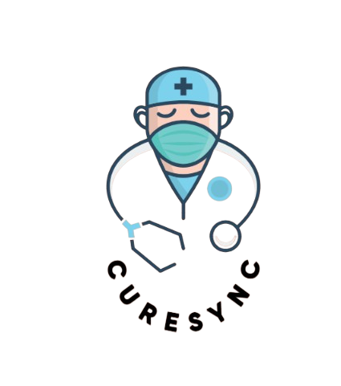
CureSync
Synchronizing Care, Healing Lives.
1

Slide 2
Presenting to :
Presented by :
Mr. Syed Eftasum Alam
MD Sharia Akter
2221-15-4929
Lecturer
Department of CSE
Daffodil International University
Riyadh Ali Mollik
221-15-5096
Dipro Paul
221-15-5666
Iftakharun Hera
221-15-4818
2

Slide 3
Table of Contents
Introduction
Problem Statement
Motivation & Objective
Feature Listing
Gap Analysis
Tools
Work Distribution
Conclusion
3

Slide 4

Introduction
A one-stop digital solution for managing medical appointments, prescriptions, billing, and patient records.
Designed for Patients, Doctors, and Admins.
Built using React.js (Frontend), Node.js + Express.js (Backend), and MySQL (Database).
4

Slide 5

Problem Statement
🩺 Problem Statement – Why CureSync?
🏥 Decentralized Appointments – Patients must visit hospitals or call to book.
📄 Scattered Medical Records – No single place to upload/view past reports.
🧑‍⚕️ Unverified Doctors – Patients risk booking with unverified professionals.
📆 Manual Schedule Management – No clarity on doctors’ hospital-wise availability.
💸 Lack of Invoicing & Tracking – No proper digital billing or medical history.
🔔 Poor Communication – No structured notifications or reminders.
5

Slide 6

Motivation & Objectives
01.
Provide a centralized and secure healthcare portal.
Ease communication and appointment booking between doctors and patients.
02.
Streamline hospital operations such as scheduling, billing, and record management.
03.
6

Slide 7




System Users
Admin
Doctor
Manages doctor registrations, system monitoring
Manages profile, availability, appointments, prescriptions
Patient
Books appointments, uploads reports, gives feedback
7

Slide 8

Core Features
Role-based Secure Login (Admin / Doctor / Patient )
Doctor Registration with Proof Upload
Admin Approval System
Doctor Schedule Management (Day / Time / Hospital)
Doctor Appointment Booking
Medical Report Upload (PDF)
Prescription Generation
Medical Test Reports Upload
Billing & Invoicing
In-Built Currency Payment Gateway (Mock)
Notification System
Search / Filter Doctors & Services
Patient Feedback
8

Slide 9
Gap Analysis
Gap | Existing Healthcare Systems | CureSync Solution
Doctor Verification | Often manual or missing | Credential upload + Admin approval
Medical Record Centralization | Dispersed or physical | Patient-uploaded digital archive
Doctor Availability Management | Manual and hospital-specific | Dynamic schedule manager (multi-hospital)
Appointment Booking | Phone/physical visit | Online with smart filters
Invoicing & Billing | Manual billing | Automated invoice generation
Notifications | Rare or manual | In-app and email alerts
Role-based Access | Weak separation | Secure login with RBAC
Feedback Mechanism | Rarely implemented | Patient reviews built-in
9

Slide 10




Tools
Frontend
Database
React.js, Tailwind CSS
MySQL
Backend
Other
Node.js, Express.js
JWT (Authentication), Multer (File Uploads), Nodemailer, VS Code, Postman, etc.
10

Slide 11

Unique Selling Points
🏥 Multi-hospital scheduling per doctor.
📄 PDF report uploads & prescription generation.
💸 Invoicing system with virtual currency.
📬 Real-time email/app notifications.
🔍 Advanced doctor search with filters.
11

Slide 12
Security
🔐
📁
📡
🔒
✅
Role-based Access Control using JWT
Secure File Uploads
REST API with status codes
Password Hashing using Bcrypt
Validation on all inputs
12

Slide 13
Future Work
Video consultation integration (Zoom/Agora)
Chat system between patient and doctor
Integration with government health IDs (e.g., NID verification)
Mobile App (React Native)
Analytics dashboard for admin insights
13

Slide 14
Work Distribution:
14

Slide 15
Conclusion
CureSync makes healthcare more accessible, manageable, and efficient.
With real-time doctor-patient connectivity, secure medical record management, and smart billing, CureSync is a complete clinic digitization platform.
15

Slide 16
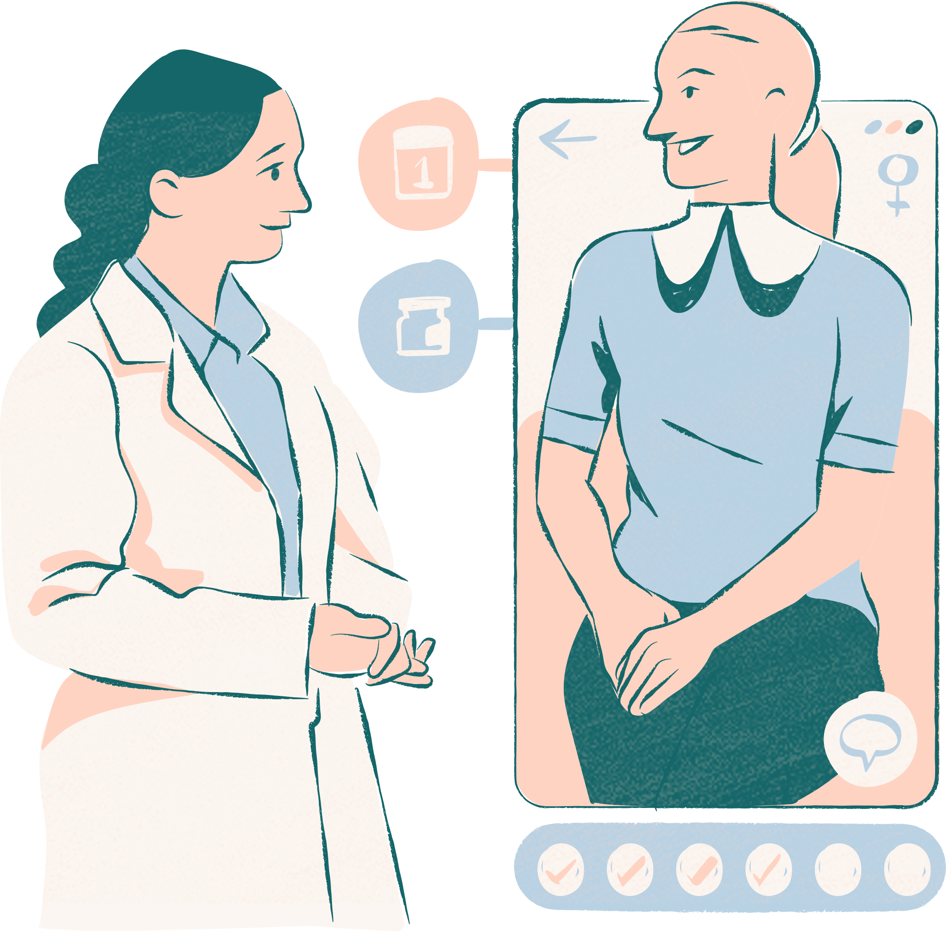
Thank you!
16

